Slide 1


Project pg-Dac
Presented by:
Namrata Godse
Himanshu Dapurkar
Prajwal Hattewar
Saurav Deshmukh
Sayali Thomare
250245920031
250245920032
250245920064
250245920078
250245920079

Slide 2
Table of contents
Title of project
Problem definition
Objective
Entity-Relation Diagram
Data Flow Diagram
Class Diagram
Use Case Diagram
Key Features
Functional Requirements
Non-Functional Requirements
Technology Stack
Challenges

Slide 3
BloodLine
In emergencies, the gap between a willing blood donor and a patient in need can mean the difference between hope and heartbreak. Our Blood Donation and Matching System website named as “BLOODLINE” bridges that gap with technology. This platform connects donors, recipients, and healthcare providers through real-time data, smart matching algorithms, and a streamlined donation process—ensuring that the right blood reaches the right hands at the right time. It's more than just a website—it’s a digital lifeline for those in need.

Slide 4
BloodLine
No real-time visibility of blood availability.
Difficulty in finding nearby blood donors in emergencies.
Problem
Definition
Enter title
Enter title
Manual coordination with blood banks.
Please add text
Please add text
Please add text

Slide 5
BloodLine
Overview
Web-based system to manage blood donations and requests
Connects donors, requesters, and blood banks in real time
Frontend developed using React
Backend powered by a relational database

Slide 6
BloodLine
Objective
Enables blood donors and requesters to connect via web.
Route blood requests to nearest blood bank automatically.
Notify donors after 3 months for donation.

Slide 7
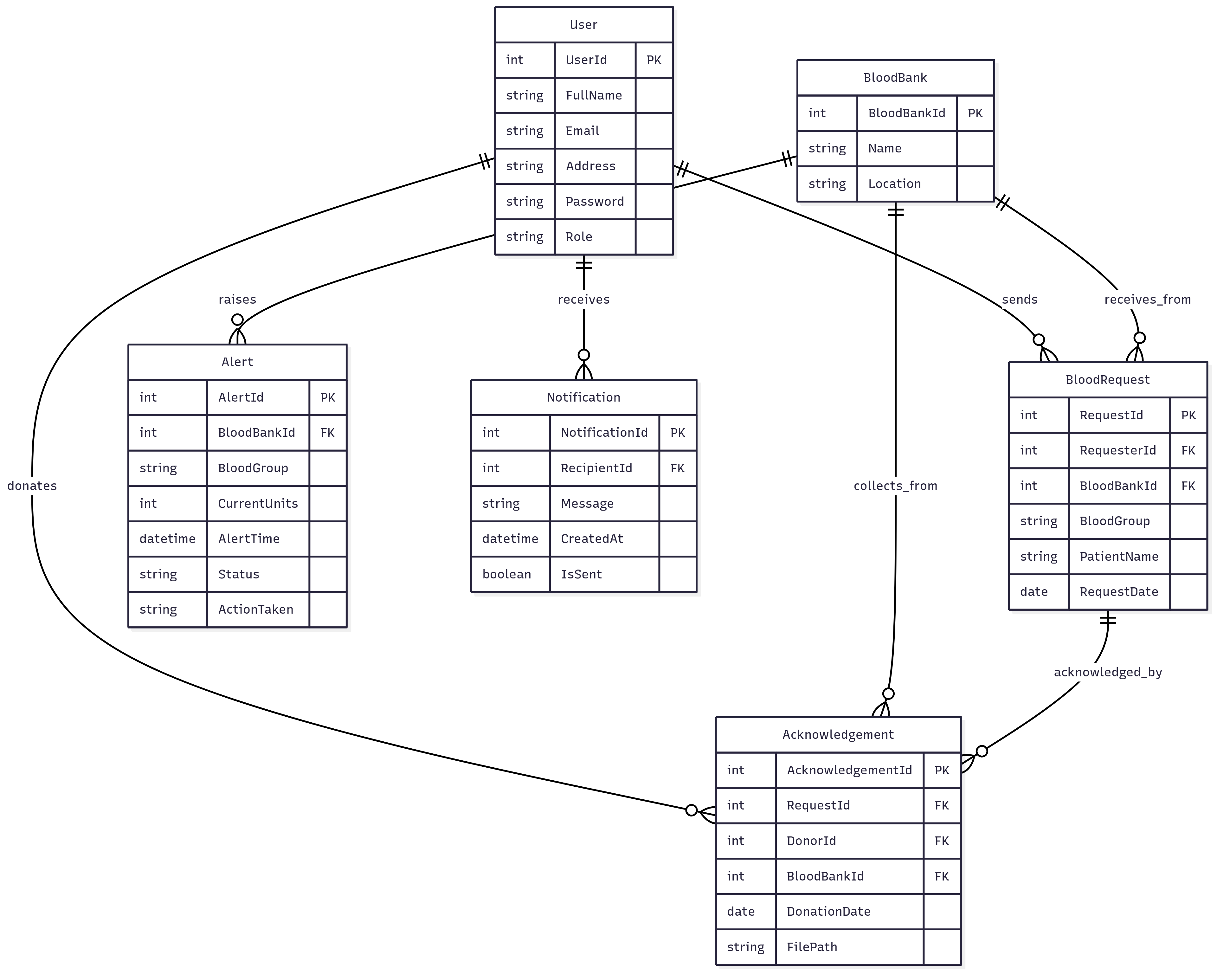
BloodLine
Entity-Relationship Diagram

Slide 8
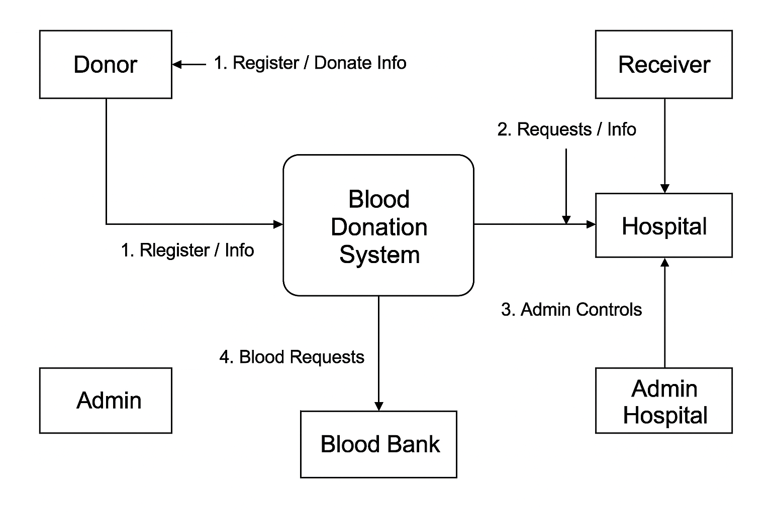
BloodLine
Data Flow Diagram
Fig. Data Flow Diagram

Slide 9
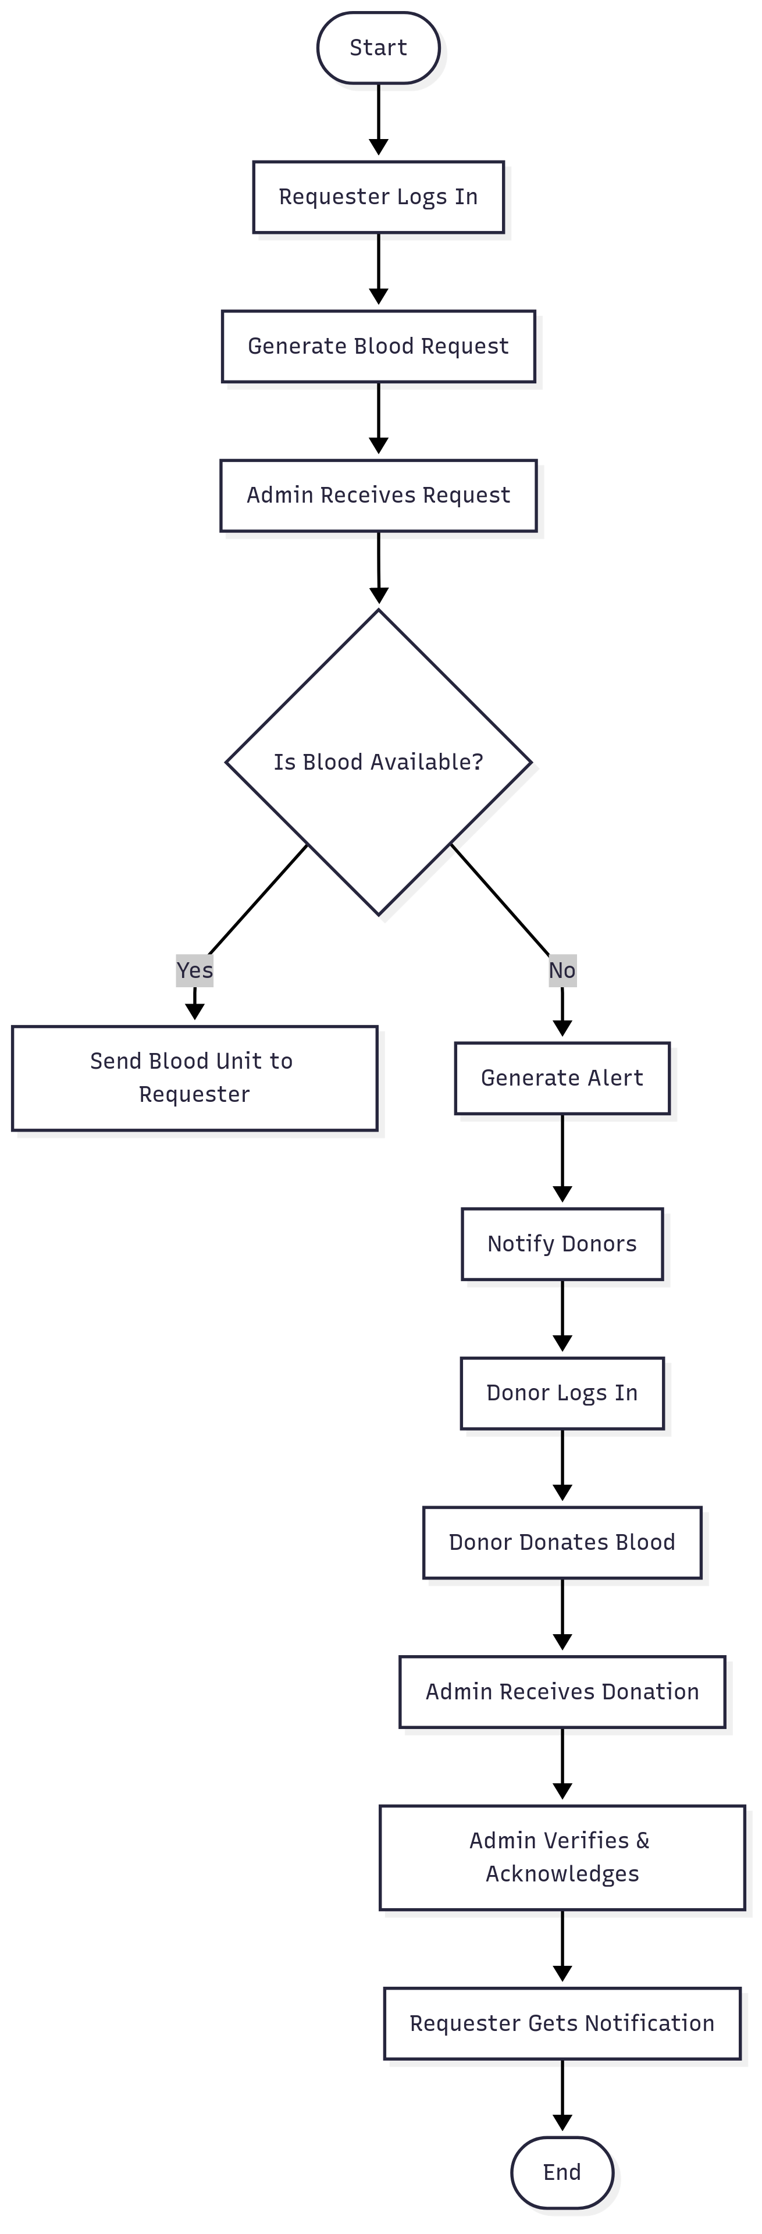
BloodLine
Activity Diagram

Slide 10
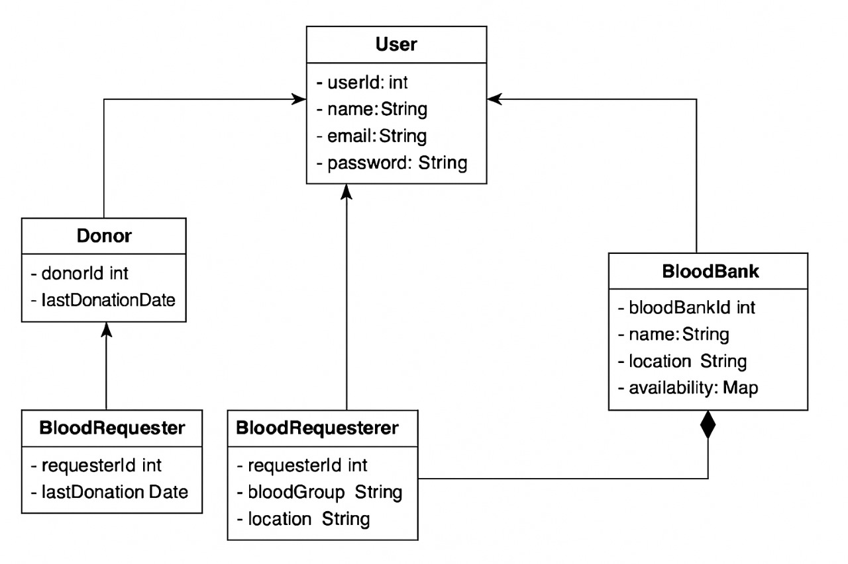
BloodLine
Fig. Class Diagram

Slide 11
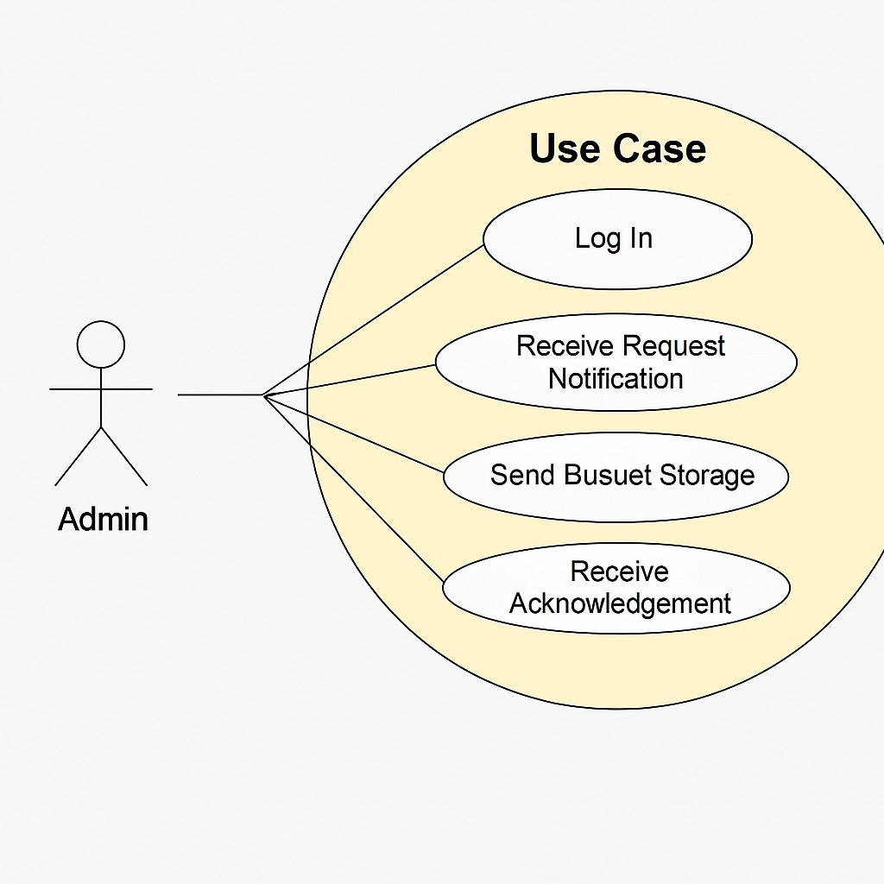
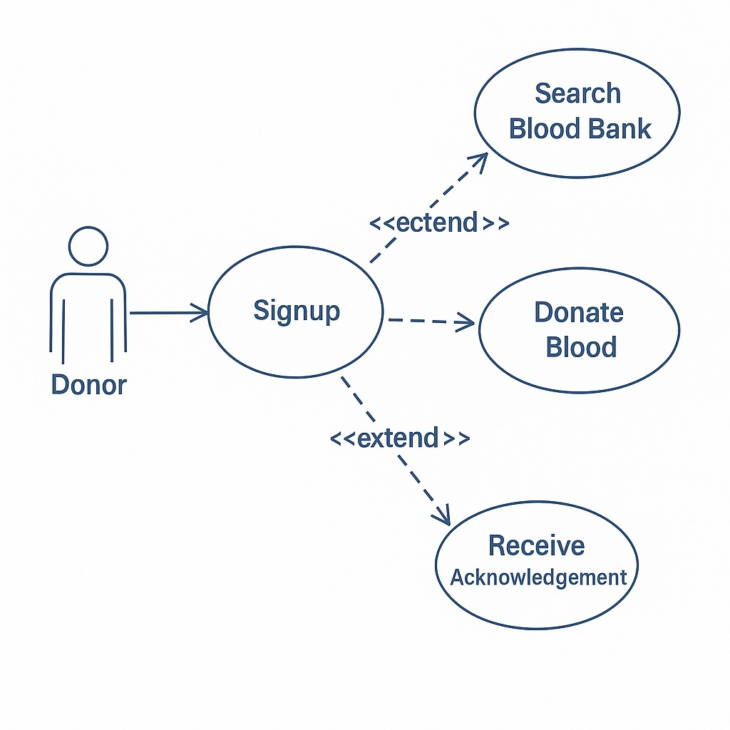
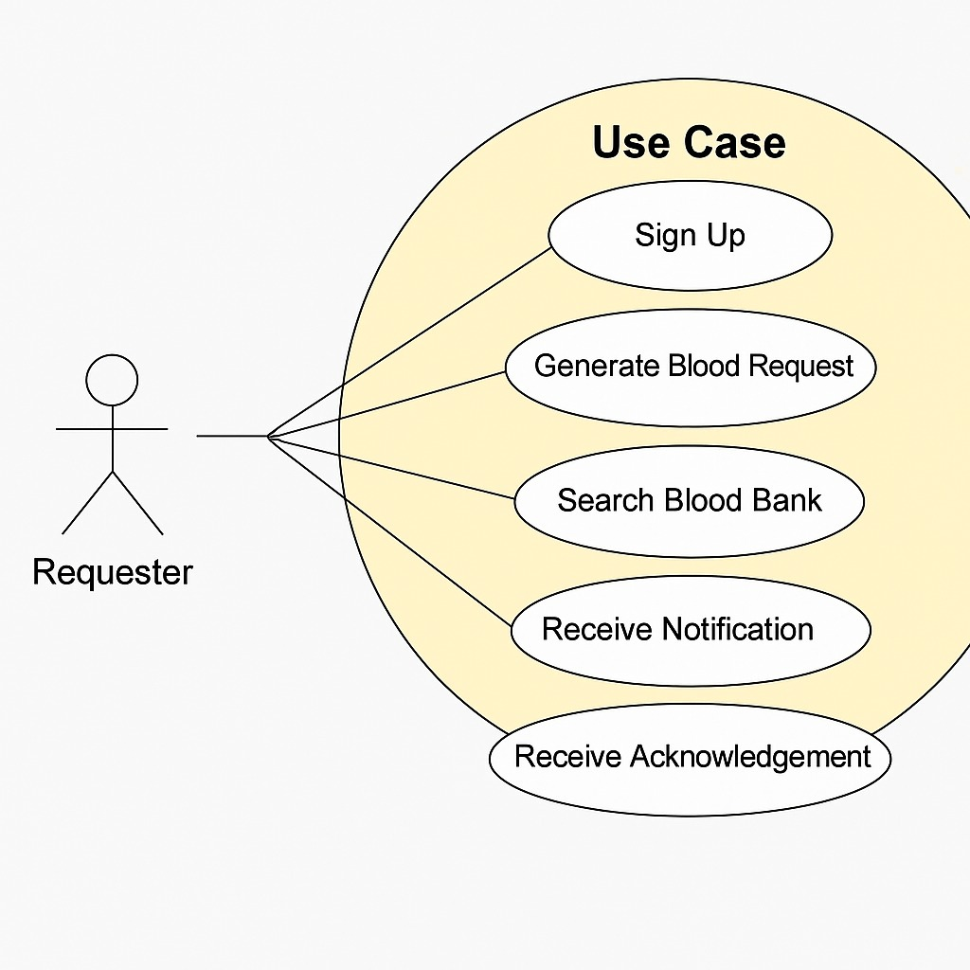
BloodLine
Use Case Diagram
extend
bloodUnit

Slide 12
BloodLine
Key Features
User registration with role selection (Donor/Requester)
Blood request system with GPS-based routing
Inventory management for blood banks
Automated donor reminders every 3 months
Real-time blood availability display

Slide 13
BloodLine
Functional Requirements
1. User registration/login
2. Select donor/requester role
3. Request blood by group and location
4. Donor info managed and stored
5. Blood banks fulfill valid requests
6. Reminder to donor after 3 months

Slide 14
BloodLine
Non-Functional Requirements
1. Fast Performance
2. High Scalability
3. Secure Data Handling

Slide 15



BloodLine
Technology Stack

Slide 16
BloodLine
Conclusion
BloodLine bridges the gap between donors and those in need.
Easy, quick, and location-based system.
Real-world scalability possible.

Slide 17
THANK YOU

